Slide 1

Heterogeneous Surface Reactions in the Troposphere:
Isomerization and Ionization of N₂O₄ on ice and silica particles
Hanna Lignell
Winter School in Theoretical Chemistry
December 15, 2010
University of Helsinki, Finland

Slide 2
Outline
Atmosphere
  Heterogeneous chemistry in the Troposphere
  Importance of interface reactions: example
Our Computational Study
  Methods
  Model systems
  Results
  Effect of dispersion
Conclusions

Slide 3
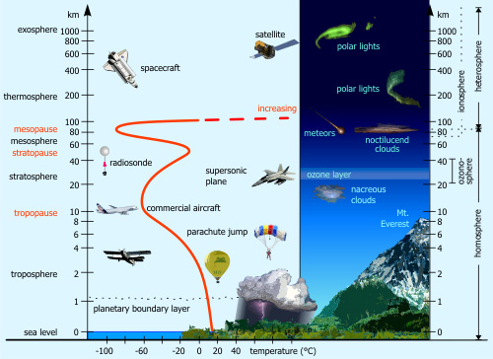
Atmosphere
Courtesy: www.kowoma.de

Slide 4


Some Surfaces in the Troposphere
Urban surfaces
Sea salt
Vegetation
Smog particles
Snowpacks

Slide 5
What is Heterogeneous Chemistry?
Chemistry which occurs in the presence of a substance of a different phase (e.g., ice, aerosols, etc.)
Heterogeneous reactions take place at the interface
  Species do not simply cross the surface by physical transport
  Interface affects the product formation and reaction rates
Bulk vs. surface reactions

Slide 6
Heterogeneous Chemistry in the Atmosphere
It was found over 20 year ago, that heterogeneous reactions occurring in the polar stratospheric clouds during sunrise are mainly responsible of the massive ozone losses at Antarctica
In the Troposphere the knowledge of the heterogeneous reactions is limited
  Thousands of reacting species and a wide range of surfaces available for these reactions
  Variations in different parameters (such as water vapour concentration, solar intensity, and meteorological conditions)
  Only a few experimental techniques available for studying the nature of surface-adsorbed species as well as their chemistry and photochemistry under atmospheric conditions (pressure 1 atm) and in the presence of water

Slide 7
Heterogeneous Chemistry in the Atmosphere
There can be lots of both experimental and computational data concerning gas phase reactions, but when molecules are adsorbed on a surface, the whole story can change!
  Bimolecular reaction rate constants change (quantitative changes)
  Outcome of the reactions change due to different reaction mechanisms at the surfaces (qualitative changes)
  Role of water
Conclusion: Interfaces (surfaces) are important!
bulk particle

Slide 8
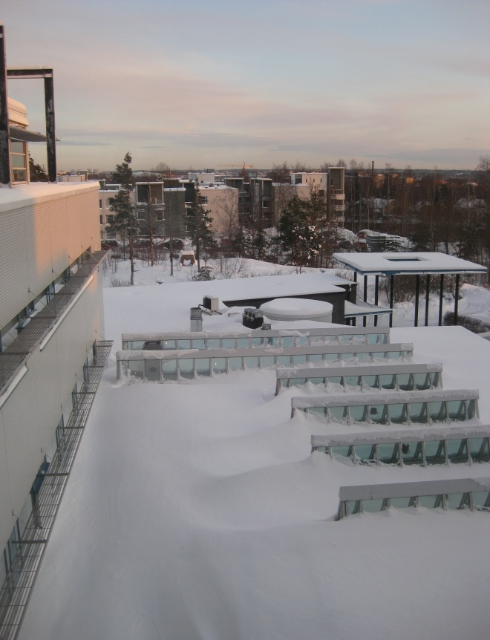
Heterogeneous Chemistry in the Atmosphere
Relevant surfaces: Water and Ice (everywhere)
  Cloud droplets
  Aerosols
  Marine layer
  Snowpacks

Slide 9
Heterogeneous Chemistry in the Atmosphere
Relevant surfaces: Silica
  Most abundant mineral in Earth’s crust
  “Urban surface”, major components of building materials, soils, roads, etc.
  The surface area containing silicates may be comparable (or larger) than the surface area of airborne particles in the planetary boundary layer
  It is expected that experimental results related to HONO formation and other NO_{x} species will have a significant contribution from heterogeneous reactions on ‘urban surfaces’
    Different HONO/NOx ratios in urban areas compared to less polluted non-urban regions
M. D. Andrés-Hernández et al., Atmos. Environ., 30, 175 (1996)

Slide 10
Heterogeneous Chemistry in the Atmosphere
Ion-Enhanced Interfacial Chemistry on Aqueous NaCl Aerosols
  E. M. Knipping, M. J. Lakin, K. L. Foster, P. Jungwirth, D. J. Tobias, R. B. Gerber, D. Dabdub, and B. J. Finlayson-Pitts, Science, 288, 301 (2000)
A combination of experimental, molecular dynamics, and kinetics modeling studies

Slide 11
Heterogeneous Chemistry in the Atmosphere
Ion-Enhanced Interfacial Chemistry on Aqueous NaCl Aerosols
  E. M. Knipping, M. J. Lakin, K. L. Foster, P. Jungwirth, D. J. Tobias, R. B. Gerber, D. Dabdub, and B. J. Finlayson-Pitts, Science, 288, 301 (2000)
In the bulk:
OH(g)
OH(aq)
Cl⁻
Reaction
Cl₂

Slide 12
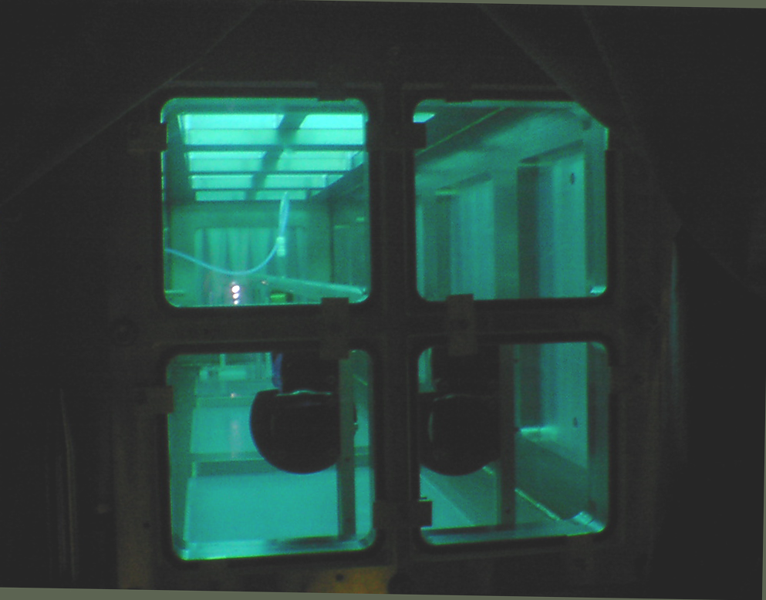
Heterogeneous Chemistry in the Atmosphere
Science, 288, 301 (2000)
Photolysis Lamps
API-MS (Cl₂)
UV/vis
(DOAS)
(O₃)
FTIR (O₃)
Notes:
DOAS = Differential Optical Absorption Spectroscopy, API = Atmospheric Pressure Ionization Mass Spectrometry

Slide 13
Heterogeneous Chemistry in the Atmosphere
Expected mechanism in the bulk phase failed totally to describe the chlorine chemistry at sea water particles
Science, 288, 301 (2000)
Cl₂ measured
O₃
predicted

Slide 14
Heterogeneous Chemistry in the Atmosphere
Simulations show that Cl⁻ is readily available at the interface
Na⁺
Cl⁻
H₂O
Science, 288, 301 (2000)

Slide 15
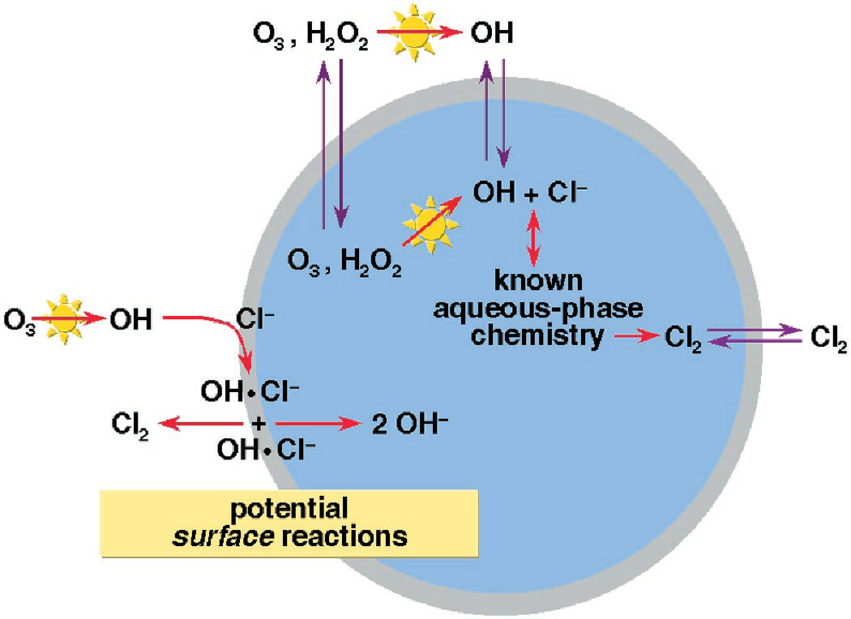
Heterogeneous Chemistry in the Atmosphere
At the interface:
Reaction does not require an acid (H⁺) for Cl₂ production
OH⁻ is produced
Science, 288, 301 (2000)

Slide 16
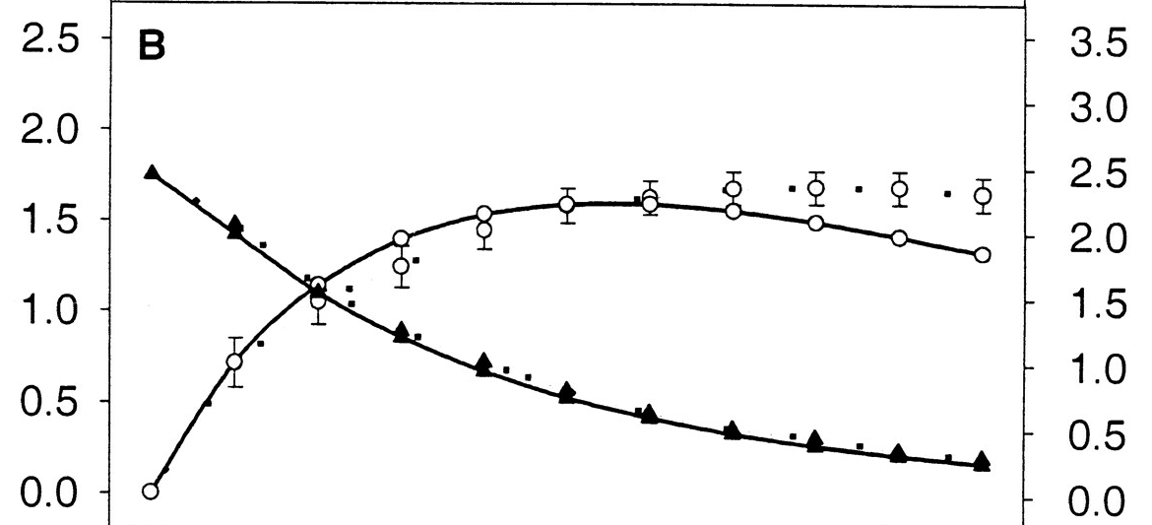
Heterogeneous Chemistry in the Atmosphere
Science, 288, 301 (2000)
With interface reaction
Cl₂, model, including interface chemistry
Cl₂, experiment
O₃
Cl₂
[Cl₂] (10¹² molecules cm⁻³)
[O₃] (10¹⁴ molecules cm⁻³)
O₃
Disaster averted!
Cl₂, model, bulk aqueous phase chemistry only
Photolysis time (min)
MAGIC model (Model of Aerosol, Gas, and Interfacial Chemistry), D. Dabdub and J. H. Seinfeld, Parallel Computing, 22, 111 (1996)
Knipping and Dabdub, Env. Sci. Technol. 37 275 (2003)
Notes:
47 Gas Species
152 Aerosols: 19 species, 8 sizes
125 Reactions

Slide 17
Heterogeneous Chemistry in the Atmosphere
NO_{x} species (especially NO₂, N₂O₄, NO₃⁻, and HNO₃) and their photochemistry in Earth’s atmospheric conditions have been studied in air-water interface
  Finlayson-Pitts et al. 2003, Phys. Chem. Chem. Phys., 5, 223 (2003)
  Ramazan et al., Phys. Chem. Chem. Phys., 6, 3836 (2003)
  Ramazan et al., J. Phys. Chem. A, 110, 6886 (2006)
More work is needed to understand chemistry of these species especially at solid surfaces (e.g. ice and silica)

Slide 18
Why are NOx’s important?
Why are NOx’s important?
Why are NOx’s important?
How Important is HONO?
Long Beach, California
In the atmosphere, the formation reaction of HONO is assumed to be the following:
HONO is subsequently released to the gas phase and rapidly photolyzes producing OH radicals
44% of OH
production
over 24 hours
B. J. Finlayson-Pitts et al., Phys. Chem. Chem. Phys., 5, 223 (2003)
Winer & Biermann, Res. Chem. Int. 20, 423 (1994)

Slide 19
Previous Studies
J. Wang and B. E. Koel, Surf. Sci. 436, 15 (1999)
A. S. Pimentel et al. J. Phys. Chem. A, 111, 2913 (2007)

Slide 20
Previous Studies
J. Wang and B. E. Koel, Surf. Sci. 436, 15 (1999)
A. S. Pimentel et al. J. Phys. Chem. A, 111, 2913 (2007)
Y. Miller, B. J. Finlayson-Pitts, and R. B. Gerber, J. Am. Chem. Soc., 131, 12180 (2009)

Slide 21
Our Study
H. Lignell, B. J. Finlayson-Pitts, and R. B. Gerber (in preparation)

Slide 22
Our Study
Theory can help us understand the isomerization mechanism from the passive form (N₂O₄) to the active form (ONONO₂) at surfaces, and the ionization process of active ONONO₂ into separate ion pair NO⁺NO₃⁻

Slide 23
Our Study
Theory can help us understand the isomerization mechanism from the passive form (N₂O₄) to the active form (ONONO₂) at surfaces, and the ionization process of active ONONO₂ into separate ion pair NO⁺NO₃⁻
Sticking of N₂O₄ on water/ice surface
  Following atomistically the process in time

Slide 24
Methods
Geometry Optimization, Transition State Search
  Turbomole (v.6.2), Gamess (12 Jan 2009)
  DFT
    B3LYP with def2-TZVP, 6-311++G(d,p)
  MP2
    aug-cc-pVDZ, 6-311++G(d,p)
Intrinsic Reaction Coordinate (IRC) Method
  Gaussian (v.03)
  DFT
    B3LYP with DZVP, 6-311++G(d,p)
Molecular Dynamics
  CP2K/Quickstep
  BLYP/TZV2P
DFT-D, DFT-D2, and DFT-D3 dispersion correction

Slide 25
Methods:
Transition States and IRC
  Transition states are needed to determine reaction mechanisms and reaction rates
    Transition State Theory (TST)
      Reaction rates
      Activation energies
Intrinsic Reaction Coordinate (IRC) Method
  Minimum energy path connecting the reactants to products via the transition state
  Going down the steepest decent path in mass weighted Cartesian coordinates
    Numerical integration of the IRC equations by variety of methods (LQA)
  Used to verify correctness of the transition state

Slide 26
Methods:
Transition States and IRC
Re
Transition State
IRC
E_{Act}
Reactants
Products

Slide 27
Methods: Molecular Dynamics
Newton’s classical equations of motion are the foundations of MD simulations:
Two coupled differential equations:

Slide 28
Methods: Molecular Dynamics
The differential equations can be numerically integrated if the initial conditions {r_{i}(0),p_{i}(0)} and forces are known
Implementation entails
  Initial configuration of the atoms
  Initial velocities or momenta from the Maxwellian distribution
  Algorithm for integrating velocities and positions (often Velocity Verlet)
  Potential surface (force field) from which the forces are derived:
  Use of periodic boundary conditions for extended systems

Slide 29
Methods: Molecular Dynamics
Ab Initio Molecular Dynamics (AIMD)
  Involves both the electronic and the nulear motions
  Employs first principles quantum mechanical methods (DFT, TDDFT)
    Kohn-Sham density functional theory
  Forces describing nuclear motion are determined directly from an electronic structure calculation “on the fly” with propagation of the nuclear motion
Two different approaches to integrate the electronic degrees of freedom:
  Born-Oppenheimer Molecular Dynamics (BOMD)
    Time independent Schrödinger equation
    Quickstep
  Ehrenfest Molecular Dynamics
    Time dependent Schrödinger equation
    Car Parrinello Molecular Dynamics (CPMD)

Slide 30
Methods: Molecular Dynamics
Ab Initio Molecular Dynamics (AIMD)
  Involves both the electronic and the nulear motions
  Employs first principles quantum mechanical methods (DFT, TDDFT)
    Kohn-Sham density functional theory
  Forces describing nuclear motion are determined directly from an electronic structure calculation “on the fly” with propagation of the nuclear motion
Two different approaches to integrate the electronic degrees of freedom:
  Born-Oppenheimer Molecular Dynamics (BOMD)
    Time independent Schrödinger equation
    Quickstep
  Ehrenfest Molecular Dynamics
    Time dependent Schrödinger equation
    Car Parrinello Molecular Dynamics (CPMD)

Slide 31
Methods: Molecular Dynamics
Ab Initio Molecular Dynamics (AIMD)
  Involves both the electronic and the nulear motions
  Employs first principles quantum mechanical methods (DFT, TDDFT)
    Kohn-Sham density functional theory
  Forces describing nuclear motion are determined directly from an electronic structure calculation “on the fly” with propagation of the nuclear motion
Two different approaches to integrate the electronic degrees of freedom:
  Born-Oppenheimer Molecular Dynamics (BOMD)
    Time independent Schrödinger equation
    Quickstep
  Ehrenfest Molecular Dynamics
    Time dependent Schrödinger equation
    Car Parrinello Molecular Dynamics (CPMD)

Slide 32
Methods: Molecular Dynamics
Kohn-Sham equations and orbitals 𝜙_{i} (r)
Once the density is given, the integral in Kohn-Sham equations is evaluated giving the electric potential V_{el}:
V_{el} is the solution to Poisson’s Equation for electrostatics
Notes:
In QS: Ewald, Martyna-Tuckerman (MT), Multipole, Wavelet to solve Poisson’s Equation

Slide 33
Methods: Molecular Dynamics
Ab Initio Molecular Dynamics (AIMD)
  Employs first principles quantum mechanical methods (DFT, TDDFT)
  Forces describing nuclear motion are determined directly from an electronic structure calculation “on the fly” with propagation of the nuclear motion
Two different approaches to integrate the electronic degrees of freedom:
  Born-Oppenheimer Molecular Dynamics (BOMD)
    Time independent Schrödinger equation
    Quickstep
  Ehrenfest Molecular Dynamics
    Time dependent Schrödinger equation
    Car Parrinello Molecular Dynamics (CPMD)

Slide 34
Methods: Quickstep
Quickstep
  Part of the freely available CP2K package
  Gaussian and plane waves (GPW) method
  Accurate density functional calculations in gas and condensed phases
  Computational cost of computing total energy and Kohn-Sham matrix scales linearly with increasing system size
  Efficiency of this method allows the use of Gaussian basis sets for systems up to 3000 atoms
  Wave function optimization with the orbital transformation technique leads to a good parallel performance
J. Vande Vondele et al., Comp. Phys. Comm., 167, 103 (2005)

Slide 35
Results

Slide 36
Results
Isomerization and ionization of N₂O₄ on ice and silica surfaces
Model Surfaces
  (SiO₂)₈
  (H₂O)₂₀
Chemical reactions at interfaces are localized
  Clusters provide at least a semiqualitative model surface

Slide 37
TS
ONONO₂(asymm)
NO⁺NO₃⁻
N₂O₄(symm)

Slide 38
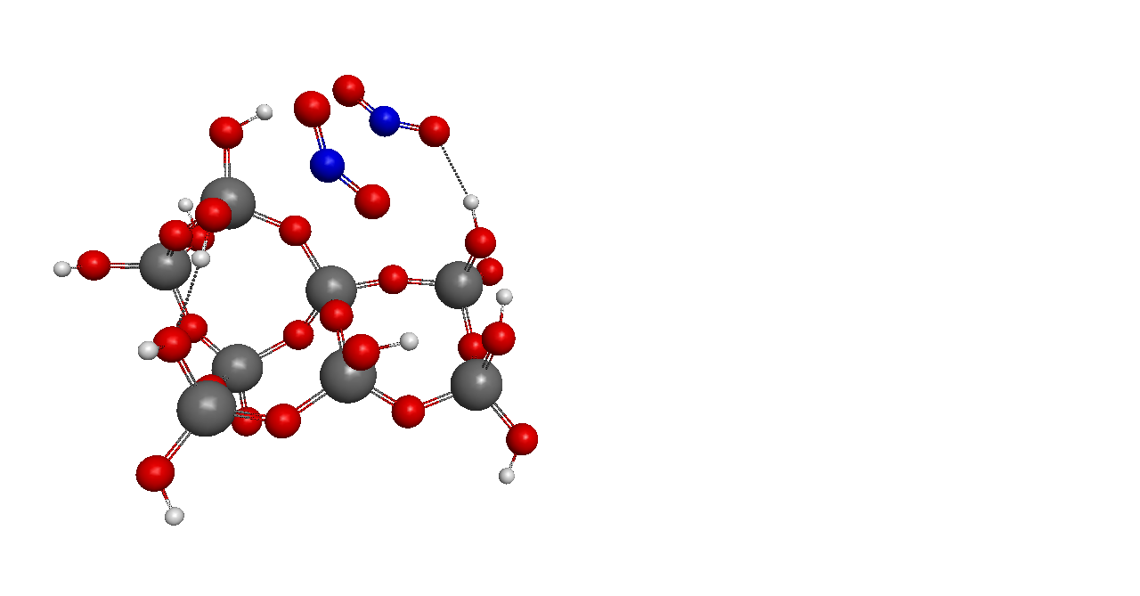
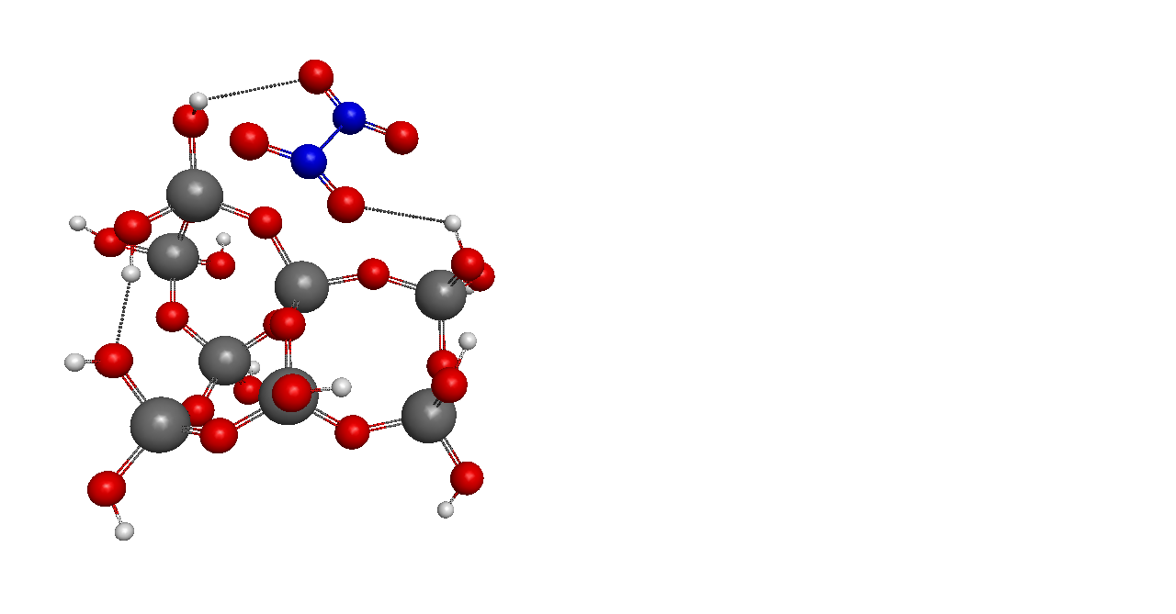
Results: N₂O₄ on silica
B3LYP/def2-TZVP
(Turbomole)
N₂O₄ (symm)
Transition State

Slide 39
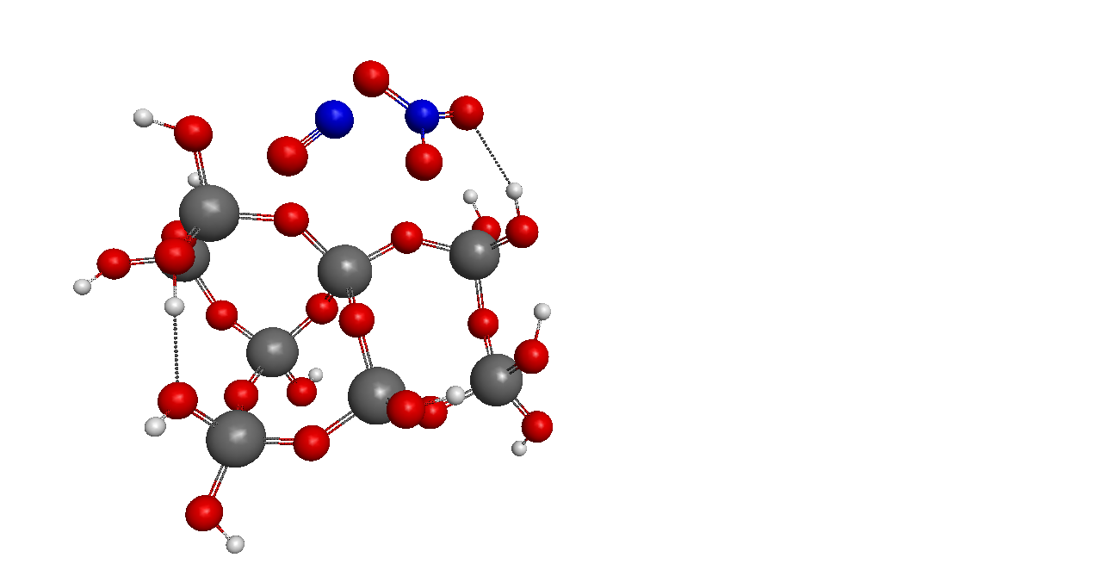
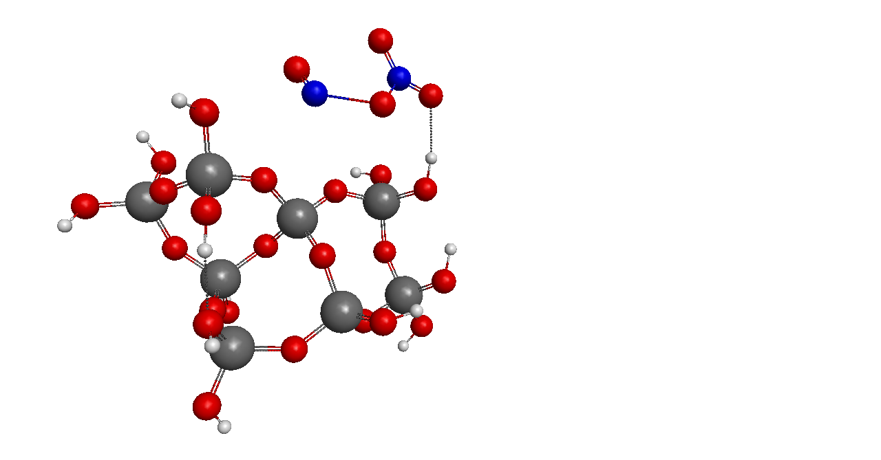
Results: N₂O₄ on silica
B3LYP/def2-TZVP
(Turbomole)
ONONO₂ (asymm)
NO⁺ NO₃⁻

Slide 40
Results: N₂O₄ on silica
r(N-O)=1.88 Å
r(N-O)=2.02 Å
-0.51
-0.55
s
+0.57
+0.53
Asymmetric N₂O₄
ONONO₂ (asymm)
NO⁺ NO₃⁻

Slide 41
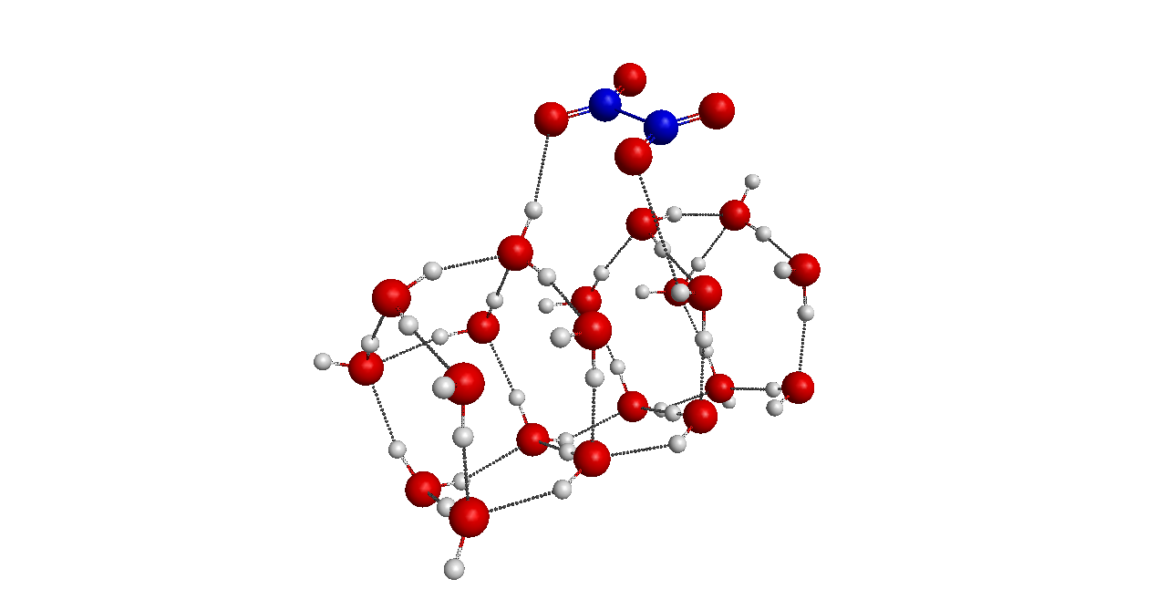
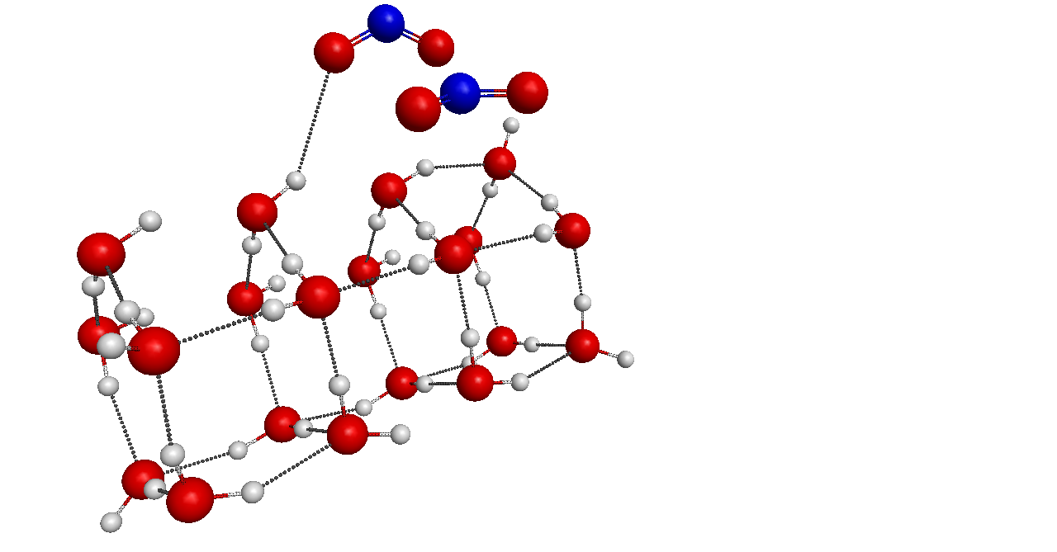
Results: N₂O₄ on Ice
B3LYP/def2-TZVP
(Turbomole)
N₂O₄ (symm)
Transition State

Slide 42
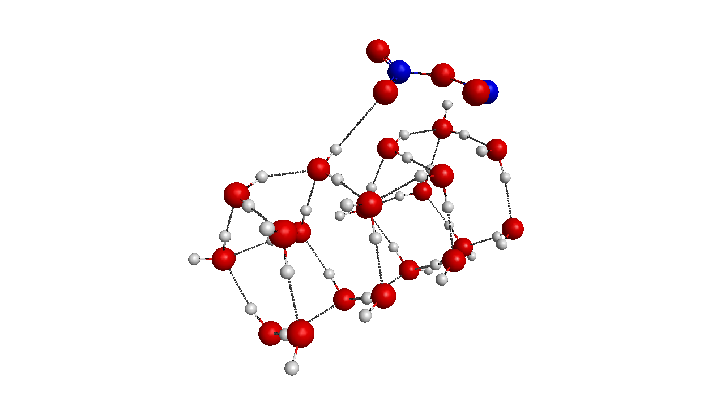
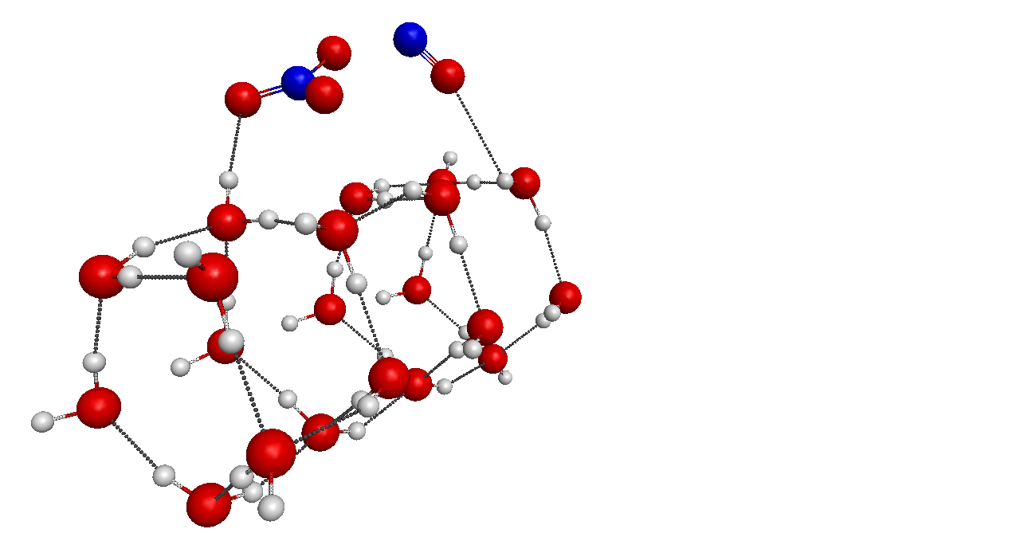
Results: N₂O₄ on Ice
B3LYP/def2-TZVP
(Turbomole)
ONONO₂ (asymm)
NO⁺ NO₃⁻

Slide 43
Results: N₂O₄ on Ice
r(N-O)=1.81 Å
r(N-O)=2.09 Å
-0.47
+0.49
-0.46
+0.46
ONONO₂ (asymm)
ONONO₂ (asymm)
NO⁺ NO₃⁻

Slide 44
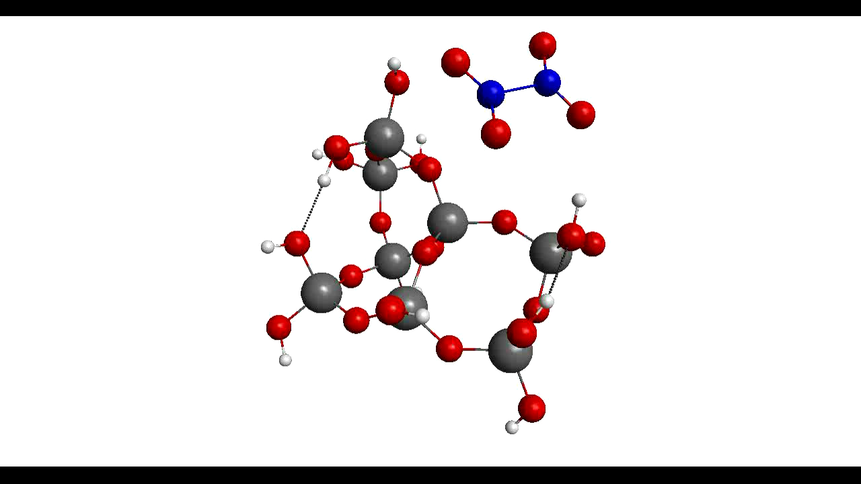
IRC for N₂O₄ (symm) to ONONO₂ (asymm) on (SiO₂)₈

Slide 45
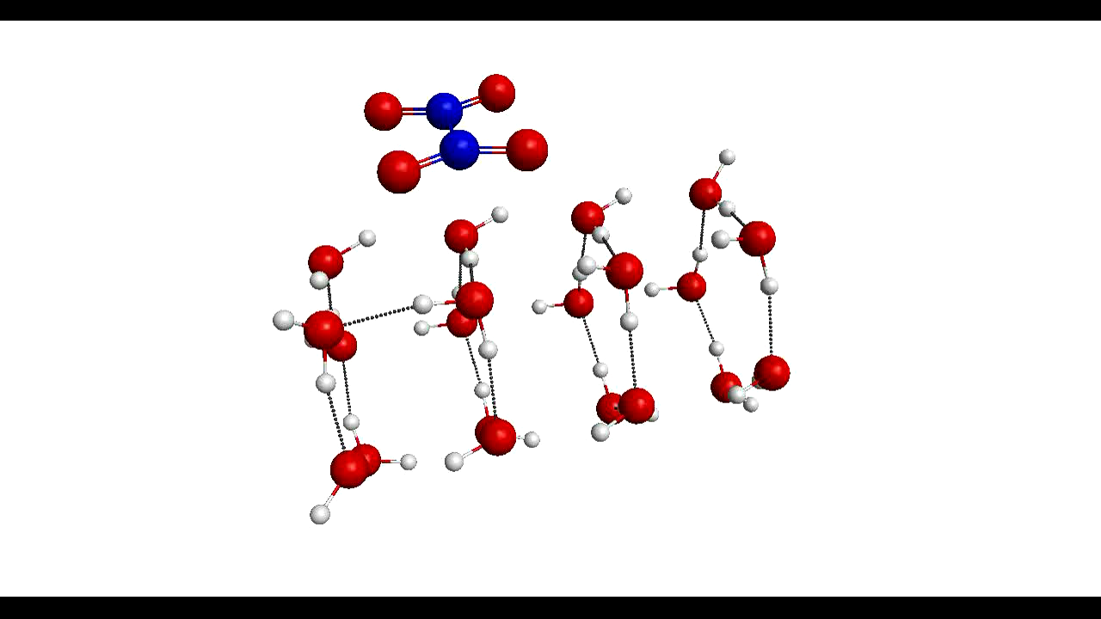
IRC for N₂O₄ (symm) to ONONO₂ (asymm) on (H₂O)₂₀

Slide 46
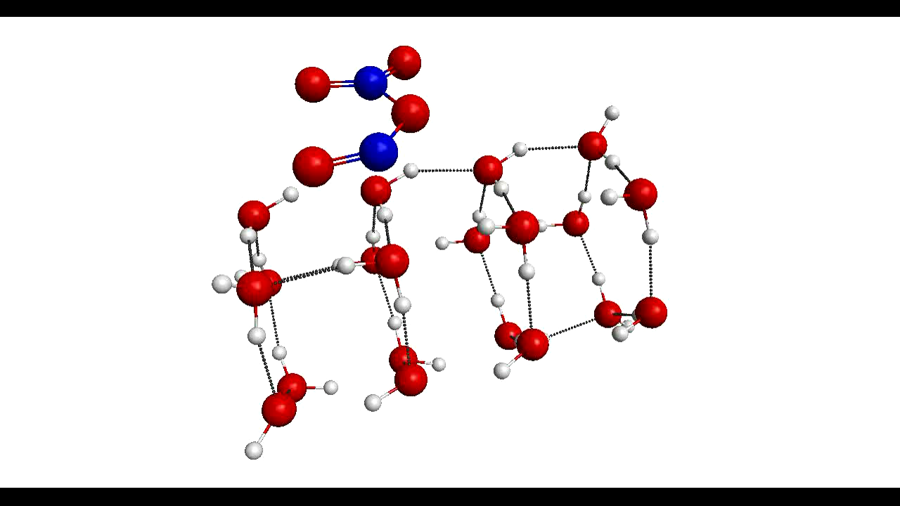
IRC for N₂O₄ (symm) to ONONO₂ (asymm) on (H₂O)₂₀

Slide 47
Effect of Dispersion
Van der Waals interactions between atoms and molecules play a role in many chemical systems
  Packing of crystals
  Formation of aggregates
  Orientation of molecules on surfaces
  ….
In order to describe dispersion interactions, a fully non-local functional is needed and a local density functional is in principle not capable of describing the long-range, nonlocal correlation effect
How can dispersion be taken into account in DFT calculations?
  Stefan Grimme:
    DFT-D, DFT-D2, and DFT-D3 corrections
    B2-PLYP double hybrid functional
S. Grimme, J. Comp. Chem., 25, 1463 (2004)
S. Grimme, J. Comp. Chem., 27, 1787 (2006)
S. Grimme et al., J. Chem. Phys., 132, 154104 (2010)
S. Grimme, J. Chem . Phys., 124, 034108 (2006)

Slide 48
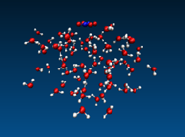
Effect of Dispersion
Without dispersion
correction
N₂O₄ @(H₂O)₇₆ , 300 K, NVT
With DFT-D3 dispersion correction
340 fs
2400 fs

Slide 49
Effect of Dispersion
Interaction Energy (kcal/mol) | DFT without dispersion correction | DFT with dispersion correction | MP2/ aug-cc-pVDZ
(Symm-N₂O₄)@ (SiO₂)₈ | 2.4 | 8.74 | -
(Asymm-N₂O₄)@ (SiO₂)₈ | 6.57 | 11.54 | -
(Symm-N₂O₄)@ (H₂O)₂₀ | 3.84 | 6.9 | 10.66
(Asymm-N₂O₄)@ (H₂O)₂₀ | - | 7.25 | 11.26

Slide 50
Conclusions
Surface reactions are necessary for correct description of reaction mechanisms on a molecular level in atmospheric environments
  Airshed modeling → Pollution control strategies
  As seen in case of Cl₂, adding interfacial chemistry improves kinetic models considerably
When modeling surface reactions it should be remembered that real situation is always more complicated:
  Reactions are complex and effect of the interface and the adsorbed species is huge
  Surface composition can change during experiment
With interface reaction
Cl₂, model, including interface chemistry
Cl₂, experiment
O₃
[Cl₂] (10¹² molecules cm⁻³)
Cl₂
[O₃] (10¹⁴ molecules cm⁻³)
O₃
Disaster averted!
Cl₂, model, bulk aqueous phase chemistry only
Photolysis time (min)

Slide 51
Conclusions
It is generally believed that reaction
is a significant source of HONO, and thus OH
  Urban airshed models often include a simple parametrization of this reaction based on rates observed in some laboratory systems
  Dangling OH-bonds possibly responsible for the isomerization reaction
2 NO₂ + H₂O → HONO + HNO₃

Slide 52
Conclusions
When modeling surface reactions it should be remembered that real situation is always more complicated:
  Reactions are complex and effect of the interface and the adsorbed species is huge
  Surface composition can change during experiment
  Long-range interactions are essential in the correct description

Slide 53
Acknowledgements
Prof. Benny Gerber
Prof. Barbara Finlayson-Pitts
Dr. Audrey Dell Hammerich
Dr. Nathan Crawford
Dr. Madeleine Pincu
Dr. Antti Lignell
Prof. Markku Räsänen
Greenplanet Cluster (Physical Sciences, UCI)
AirUCI
Finnish Cultural Foundation

